Slide 1

BGSW- SJCE Academy Connect Automotive Diagnostics
- Sathyamoorthy Ilangovan

Slide 2
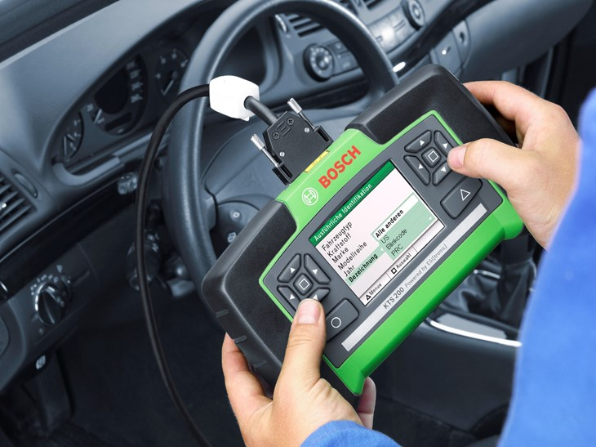

Automotive Diagnostics
Agenda
Automotive Diagnostic Overview
UDS - Unified Diagnostic Services
AUTOSAR Diagnostic Stack
02

Slide 3


Diagnostics Overview

Slide 4
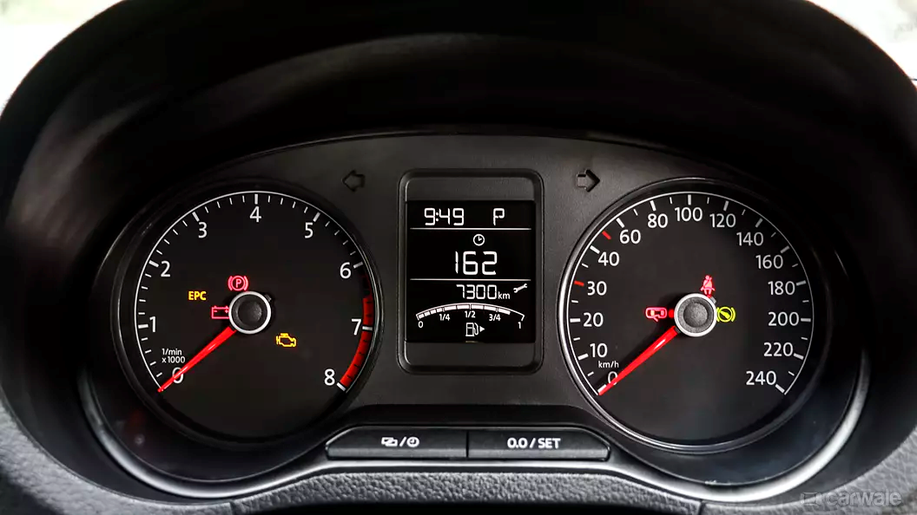
Automotive Diagnostics
Dashboard – Instrument Cluster
Image credits: Carewale.com
04

Slide 5


Automotive Diagnostics
Dashboard Warning Symbols
Airbag Problem
Coolant Level Low / Coolant Temperature High
This fault code means airbag or belt tensioning system faulty, or passenger airbags deactivated.
This red warning light means you should stop and check coolant levels.
05

Slide 6

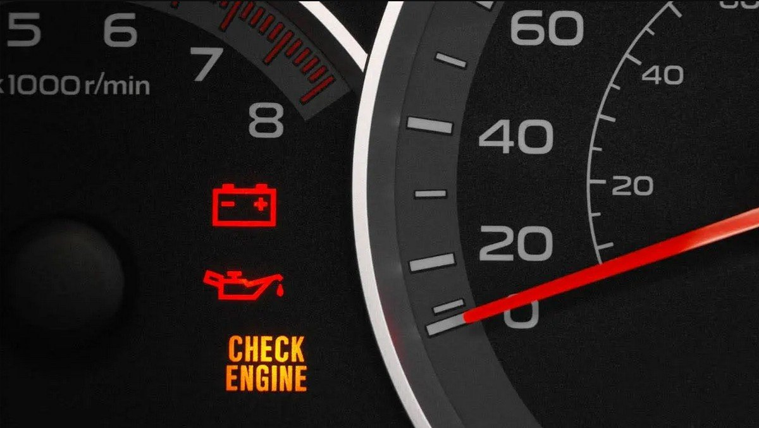
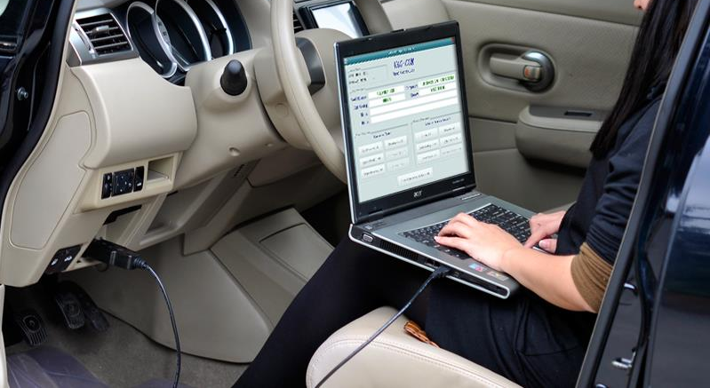
Automotive Diagnostics
Diagnostics Overview
Root cause of a problem can be easily identified with diagnostic service
Then,
Now,
Difficult to find out the actual root-cause of a problem
06
Notes:
Reference: Video to show https://youtu.be/7Y4JdXx27r8?t=13

Slide 7
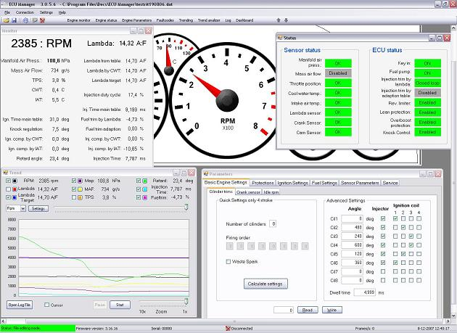
Automotive Diagnostics
Core Functionalities of Vehicle Diagnostics
ECU Configuration: Parameters like vehicle variant, Coding value can be configured in ECU
ECU Calibration: Adjust the sensor measurements , and use them in calculations
Status & Failure Information: It provides status information like ECU status, Error code.
ECU Control: It allows user to control the ECU like session control, Routine control, Communication Control, IO control and ECU reset.
Memory Access: It enables user to read\write data into the ECU memory.
Reflash & SW Update: ECU reprogramming (Flashing) and dataset download can be done using Data Transfer services
07

Slide 8
Automotive Diagnostics
Diagnostics Overview
Calibrate the ECU
Adjust the sensor measurements , and use them in calculations
Configure the ECU for different vehicle variants
Reflash the SW & Data Updates
Either remotely or at Plant or at Garage
Inspection & Repair
Enquire ECU Faults at Garage , Analyze & Fix
Assembly line Inspection
Test ECU functionality at ECU Supplier Plant before deliver to OEM
Verify & accept ECU functionality at OEM plant , before fixing in Vehicle
08

Slide 9

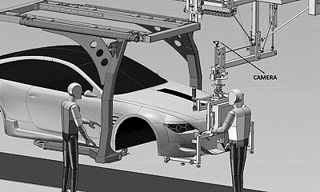
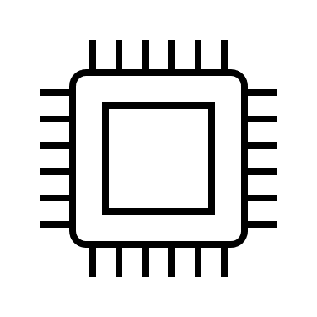


Automotive Diagnostics
Who uses Diagnostics?
Production Line Engineer
System Tester
ECU
Developer
Service Engineers
09

Slide 10
Unified Diagnostic Services

Slide 11

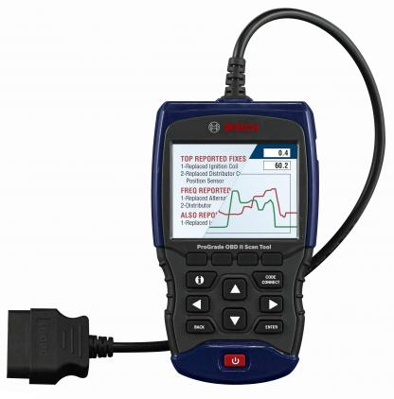


Automotive Diagnostics
UDS – Unified Diagnostic Services
SAE:
Standard protocol Tester
communication
UDS
11
Notes:
Reference images:
https://www.boschdiagnostics.com/products/pro-grade-obd-ii-scan-tool
https://purepng.com/public/uploads/large/purepng.com-volvovolvovolvo-carsvolvo-automobilevolvo-stylish-carvolvo-trucks-1701527682700nvgg9.png
Picture reference: https://hondasemaranginfo.com/mobil/harga-honda-accord/
The robust and capable Bosch OBD 1350 is packed with the features you want for quick diagnosis of vehicle system faults on OBD II equipped vehicles. This powerful tool reads ABS codes for most GM, Ford, Chrysler, Toyota, Honda, Nissan, Hyundai, BMW, Mercedes, Smart, VW, Audi, Jaguar, Land Rover, and Volvo vehicles. Reads and displays SRS/airbag codes for most GM, Ford, Chrysler, Toyota, Honda, Nissan, Hyundai, BMW, Jaguar, Land Rover, Volvo, Volkswagen, and Audi vehicles.
The OBD 1350 includes enhanced Powertrain/ABS datastream for Domestic, Asian, and European vehicles. Performs Ford 'On Demand' tests which turn on switches and actuators in the engine. Diagnose vehicle issues with included CodeConnect. With over 26 million fixes in its database, CodeConnect provides the most likely reason warning lights are on. The OBD 1350 also offers transmission enhanced live datastream for GM and Ford and can monitor fuel mileage, including MPG, Avg MPG, elapsed time, distance, fuel used and average speed.
The AutoID feature automatically populates the tool with vehicle data for most 2000 and newer vehicles. Reset oil lights, check engine lights, or perform a battery life reset (for battery replacement on newer vehicles). VIEW all modes of OBD II global data including mode 6 and O2 monitor test and monitor battery, alternator, and charging systems. The OBD 1350 allows you to graph data - (1996 and newer) and read, record and play back live sensor data.
Menus and options can be displayed in English, French, or Spanish. Reads, displays, and erases generic, enhanced diagnostic trouble codes (DTCs). Additonal features include: freeze frame data, emissions readiness status (I/M readiness monitors), built-in OBD II code library, PC compatibility and a large, backlit, graphic LCD screen. Battery powered for review of vehicle data off vehicle. Compatible with ALL 1996 and newer import and domestic vehicles (OBD II & can), as well as '94 and '95 OBD II compliant vehicles.

Slide 12
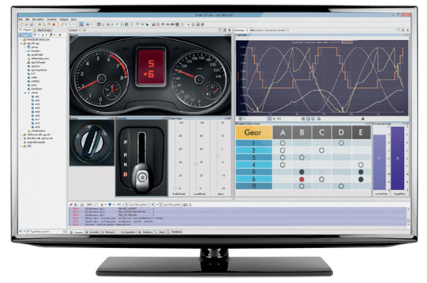

Automotive Diagnostics
UDS – Unified Diagnostic Services
UDS stands for Unified Diagnostic Services. It is an ISO 14229 defined application layer protocol.
It is Client - Server communication. Client is tester and Server is ECU. Client initiates the communication.
Network Independent Design (Network is abstracted by PduR)
UDS specifies set of services, Request & Response msg formats, protocol timing parameters
Service - Client request a server to get a specific data or to perform a specific operation with a Unique Service ID is called service.
Service ID- UDS defined a unique ID for each service, so that server can understand the client intended operation/service and perform so. It is also called as service ID/ Msg ID
Service Request with Unique Service ID
ECU
Service Response
Server
Client
12

Slide 13

Automotive Diagnostics
UDS – Collection of Diagnostic Services
What are the available services.
Formats of the request message.
Formats of the response message.
What must be the timing parameters in communication.
Service handling by tested and ECU.
ISO 14229
13

Slide 14
Automotive Diagnostics
UDS – Unified Diagnostic Services
ECU
Application
UDS(ISO 14229)
protocol
RTE
Diagnostics application
Communication stack
Serial Interface
Vehicle Network Bus
(CAN/Eth/Flexray)
Network Interface
Port access via OBD connector in Vehicle
CAN/Eth/Flexray
Diagnostics is an UDS(ISO 14229) protocol-based application which handles communication between ECU and Diagnostics tester tool.
It supports Half-Duplex communication only.
ISO 14229 allows a diagnostic tester (client) to control diagnostic functions in an on-vehicle Electronic Control Unit (ECU, server) embedded in a vehicle.
Modern Diagnostics evolved to provide all possible data associated with the failure(DTC’s) and ECU specific data. It also provides some level of control over the ECU.
14

Slide 15

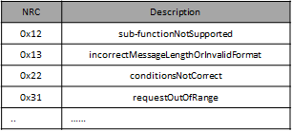
Automotive Diagnostics
UDS – Message Formats
ECU
Client
Request Msg Format
Server
1 byte
1 … n bytes
Service ID
Sub Function
Positive Response Msg Format
Processing Service
1 byte
1 … n bytes
Service ID + 0x40
Data
Negative Response Msg Format
1 byte
1 byte
1 byte
0x7F
Service ID
Negative Response Code
Indication of Negative response
If more than one NRC for a req, then NRC will be sent based on the defined priority
15

Slide 16
Automotive Diagnostics
UDS - Services
Diagnostic and Communication Management functional unit
Service | Description
DiagnosticSessionControl (0x10) | The client requests to control a diagnostic session with a server(s).
ECUReset (0x11) | The client forces the server(s) to perform a reset.
SecurityAccess (0x27) | The client requests to unlock a secured server(s).
CommunicationControl (0x28) | The client controls the setting of communication parameters in the server (e.g., communication baudrate).
Authentication(0x29) | more modern methods of authentication than are permitted by the Security Access (0x27) service
TesterPresent (0x3E) | The client indicates to the server(s) that it is still present.
AccessTimingParameter (0x83) | The client uses this service to read/modify the timing parameters for an active communication.
SecuredDataTransmission (0x84) | The client uses this service to perform data transmission with an extended data link security.
ControlDTCSetting (0x85) | The client controls the setting of DTCs in the server.
ResponseOnEvent (0x86) | The client requests to setup and/or control an event mechanism in the server.
LinkControl (0x87) | The client requests control of the communication baudrate
Upload Download functional unit
Service | Description
RequestDownload (0x34) | The client requests the negotiation of a data transfer from the client to the server.
RequestUpload (0x35) | The client requests the negotiation of a data transfer from the server to the client.
TransferData (0x36) | The client transmits data to the server (download) or requests data from the server (upload).
RequestTransferExit (0x37) | The client requests the termination of a data transfer.
RequestFileTransfer (0x38) | The client requests the negotiation of a file transfer between server and client.
16

Slide 17
Automotive Diagnostics
UDS - Services
Data Transmission functional unit
Service | Description
ReadDataByIdentifier (0x22) | The client requests to read the current value of a record identified by a provided dataIdentifier.
ReadMemoryByAddress (0x23) | The client requests to read the current value of the provided memory range.
ReadScalingDataByIdentifier (0x24) | The client requests to read the scaling information of a record identified by a provided dataIdentifier.
ReadDataByPeriodicIdentifier (0x2A) | The client requests to schedule data in the server for periodic transmission.
DynamicallyDefineDataIdentifier (0x2C) | The client requests to dynamically define data Identifiers that may subsequently be read by the readDataByIdentifier service.
WriteDataByIdentifier (0x2E) | The client requests to write a record specified by a provided dataIdentifier.
WriteMemoryByAddress (0x3D) | The client requests to overwrite a provided memory range.
Stored Data Transmission functional unit
Service | Description
ClearDiagnosticInformation (0x14) | Allows the client to clear diagnostic information from the server (including DTCs, captured data, etc.)
ReadDTCInformation (0x19) | Allows the client to request diagnostic information from the server (including DTCs, captured data, etc.)
InputOutput Control functional unit
Service | Description
InputOutputControlByIdentifier (0x2F) | The client requests the control of an input/output specific to the server.
Routine functional unit
Service | Description
RoutineControl (0x31) | The client requests to start, stop a routine in the server(s) or requests the routine results.
17

Slide 18
Automotive Diagnostics
UDS – Service 0x10
The DiagnosticSessionControl service is used to enable different diagnostic sessions in the server(s).
Default Session - Enables the default diagnostic session in the server(s)
Extended Diagnostic Session - Enables all diagnostic services required to support the adjustment of functions like "Idle Speed, CO Value, etc." in the server's memory.
Programming Session - Enables all diagnostic services required to support the memory programming of a server.
0x10 Request
Positive Response
Support NRC
Byte | Description | Value
01 | Request SID [Diagnostic Session Control] | 0x10
02 | Sub-function | 0x01 – Default Session 0x02 – Programming Session 0x03- Extended Diagnostics Session 0x04- safety System Diagnostic Session
Byte | Description | Value
01 | Request SID + 0x40 | 0x50
02 | Sub-function | Same as req
03 - 06 | sessionParameterRecord | 2 bytes - P2Server_max in ms 2 bytes - P2*Server_max in 10ms
NRC | Description
0x12 | sub-functionNotSupported
0x13 | incorrectMessageLengthOrInvalidFormat
0x22 | conditionsNotCorrect
ECU
Client
Server
10 01
Positive Res: 50 01 00 32 01 F4
Negative Res: 7f 10 12
18

Slide 19
Automotive Diagnostics
UDS – Service 0x27
The purpose of this Security Access service is to provide a means to access data and/or diagnostic services, which have restricted access for security, emissions, or safety reasons. Diagnostic services for downloading/uploading routines or data into a server and reading specific memory locations from a server are situations where security access may be required.
0x27 Request Seed
Positive Response
Support NRC
Byte | Description | Value
01 | Request SID [Security Access ] | 0x27
02 | Sub-function = RequestSeed | 0x01, 0x03,0x05, 0x07…..0x7D
03-n | securityAccessDataRecord[] | N number of user defined data bytes (optional)
Byte | Description | Value
01 | Request SID + 0x40 | 0x67
02 | Sub-function | Same as req
03 - n | securitySeed[] | Mandatory for Request Seed. Optional for Send Key
NRC | Description
0x12 | sub-functionNotSupported
0x13 | incorrectMessageLengthOrInvalidFormat
0x22 | conditionsNotCorrect
0x24 | requestSequenceError
0x31 | requestOutOfRange
0x35 | invalidKey
0x36 | exceededNumberOfAttempts
0x37 | requiredTimeDelayNotExpired
0x27 Send Key
Byte | Description | Value
01 | Request SID [Security Access ] | 0x27
02 | Sub-function = sendKey | 0x02, 0x04,0x06, 0x08…..0x7E
03-n | securityKey | N bytes of Key
ECU
Client
Server
Request seed: 27 01
Seed can be generated from any random functions / parameters
67 01 36 57
Compute key by applying some logic on seed. Ex 2’s compliment
Send Key: 27 02 C9 A9
Key is verified by the server. If it is ok, unlock & send positive response
67 02
19

Slide 20
AUTOSAR Diagnostics Stack

Slide 21
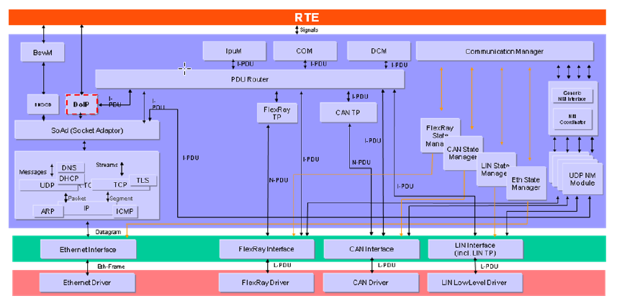
Automotive Diagnostics
AUTOSAR Diagnostics Stack
21

Slide 22


Automotive Diagnostics
OSI Layer Vs Diagnostics Stack
OSI Layers
Application
Presentation
Session
Transport
Network
Data Link
Physical
Protocols
UDS (ISO 14229-1)
ISO 15765-2
ISO 11898
Components
DCOM
DCM
CanTp
Can Driver
Service Execution
Pre service Execution and Filtering
Response Generation
Assembly of frames to Msg
Segmentation of Msg to Frames
Reception of CAN frames
Transmission of CAN frames
22

Slide 23
Automotive Diagnostics
DCM Overview
DCM stands for Diagnostic Communication Manager. It is an AUTOSAR defined application layer module which implements UDS (ISO-14229) protocol.
Network Independent Design (taken care by PduR) which Ensures flow of diagnostic data and Manages diagnostic states especially diagnostic sessions and security states
Data transfer size can be more than single N-PDU size. HenceDCM stack needs a separate module called Transport protocol (TP) which does the assembling of data (request) while receiving and segmenting the data (response) while sending from the Server.
Transport protocol is medium dependent. i.e. CAN medium has CAN-TP, FlexRay medium has FrTp etc. Pdu Router (PduR) Provides the medium encapsulation to DCM module.
Functional Blocks of DCM
DCM
Diagnostics Service Processing:
Diagnostic Service Processing - is mainly a container for completely implemented diagnostic services that are common amongst the different applications (e.g. access to the fault data) and thus do not need to be implemented by the application.
DSP
Diagnostic Service Dispatcher:
does the work of receiving new diagnostic requests over a network and forwarding the same to data processor
Positive Response, Negative Response
Suppression of Positive Responses
Suppression of certain negative responses for Functional addressing
DSD
DSL
Diagnostics Session Layer:
Ensures data flow concerning diagnostic requests and responses.
Layer to support “concurrent” tester present (keep alive logic)
Support Periodic Transmission, Response on Event and Paged Buffer handling
23

Slide 24
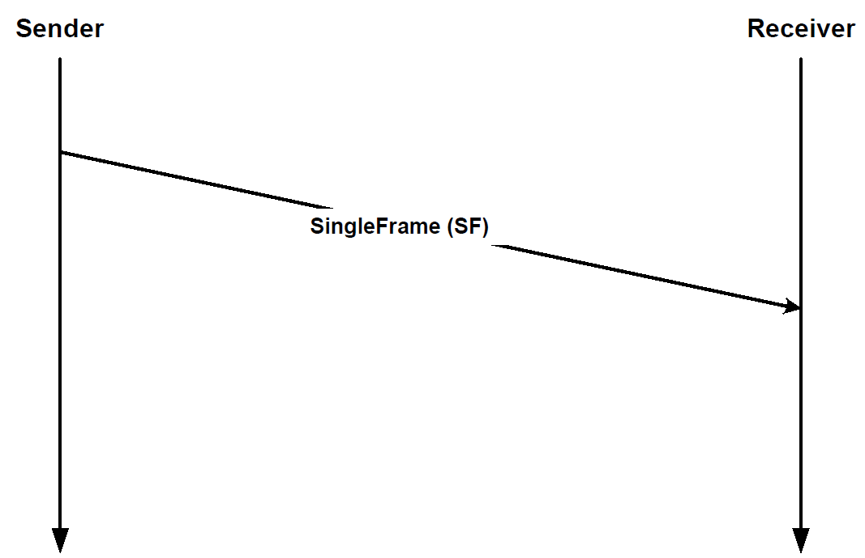
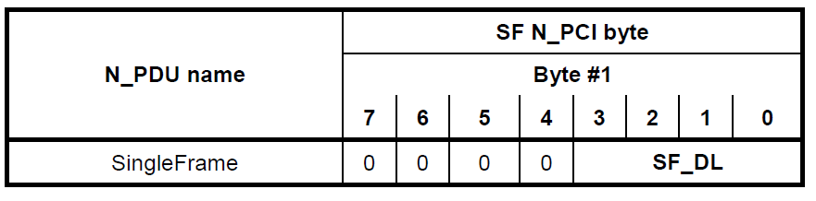
Automotive Diagnostics
CanTp Overview
This protocol describes the overall functionality of the network & Transport layer.
This part of ISO 15765 specifies an unconfirmed network layer communication protocol for the exchange of data between network nodes, e.g. from ECU to ECU, or between external test equipment and an ECU.
If the data to be transferred do not fit into a single CAN frame, a segmentation method is provided.
Unsegmented Msg – Single Frame
24

Slide 25
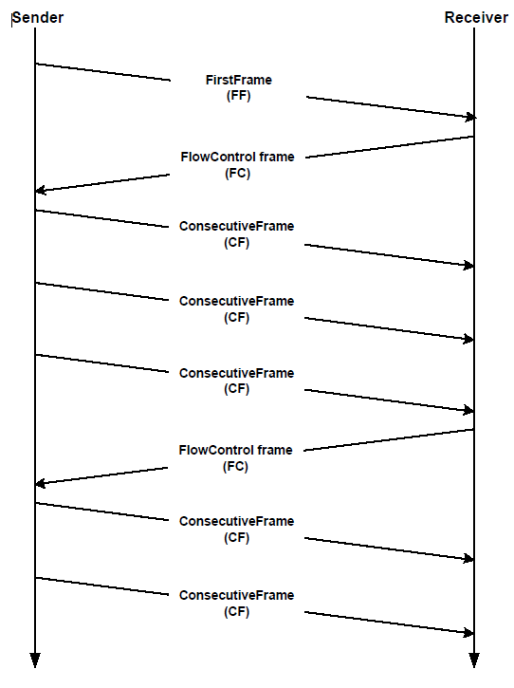
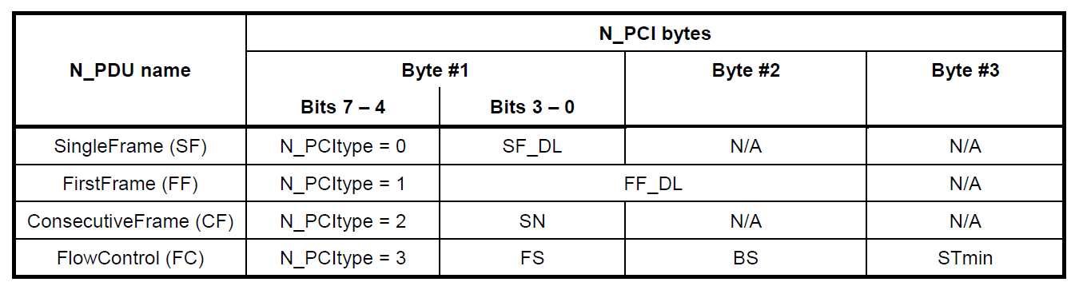
Automotive Diagnostics
CanTp Overview
Segmented Msg – Multi Frame
25

Slide 26

Automotive Diagnostics
QUESTIONS
26

Slide 27

Thank you!

